Slide 1
5G Waveform Modulation & Demodulation
Prepared By:
Tawsif Ahmad Thakur Bhattarai Luvpreet Kaur

Slide 2
5G Overview
High Data Rate (can achieve 1.4 Gbps median speed for 28GHz mmWave)
Low communication Latency (about 1ms.)
High Bandwidth efficiency
High user density
5G waveforms are basically OFDM signals.
Waveforms are strengthened by using Baseband filtering
Transmission is done incorporating MIMO technologies

Slide 3
5G Block Diagram
5G uses OFDM along with some specific features
Block
IFFT
Symbol Mapping
Add Cyclic Prefix
Binary Data
Random Channel
Figure : Transmitter Side

Slide 4
5G Block Diagram
Block
FFT
Received Signal from channel
Remove
Cyclic
Prefix
Detection
Detected Symbols
Figure : Receiver Side

Slide 5
Some Parameters
FFT/IFFT Block size = 32
Number of FFT/IFFT Blocks = 50
Cyclic Prefix Length = 20
White Noise SNR = 18 dB
Baseband Filter Length = 513
Baseband Filter Type: Windowed Sinc function Prototype filter

Slide 6
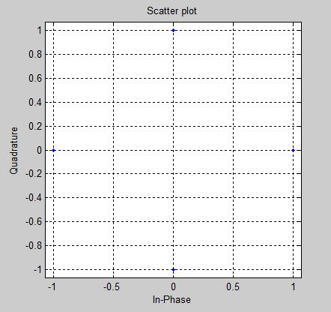
Symbol Mapping
We used QPSK modulation (Gray encoding)
01
11
00
10
Bit Pair | Symbol
00 | 1
01 | j
11 | -1
10 | -j

Slide 7
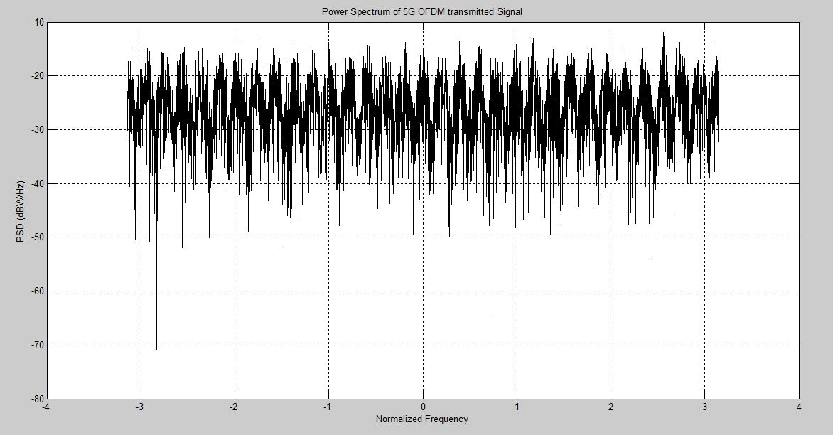
PSD of Modulated Waveform

Slide 8
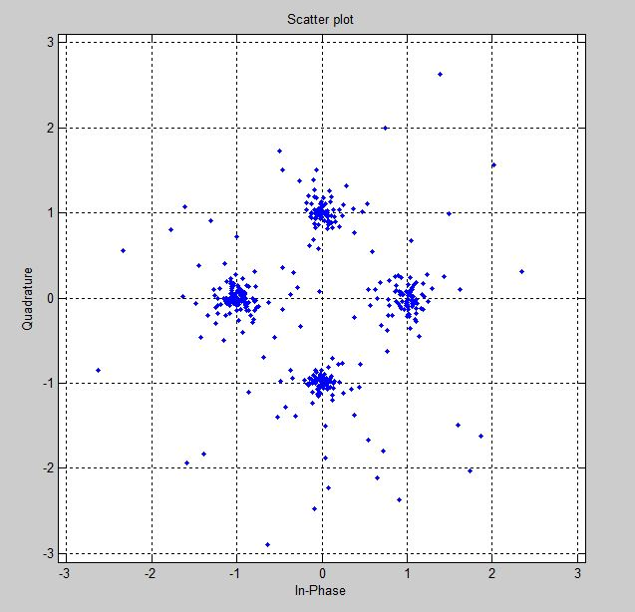
Symbol Detection
For symbol detection, we used the G matrix
G = fft([channel(2:end) . . . 0 …. 0 channel(1)]);
Then, we performed element-wise division between each CP removed FFT block output and the G matrix

Slide 9
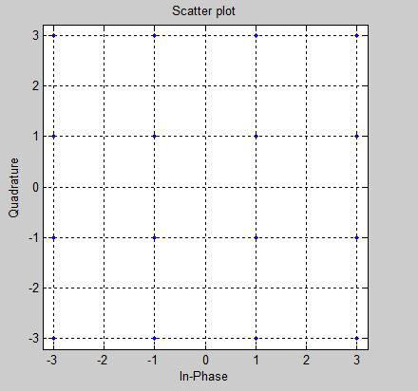
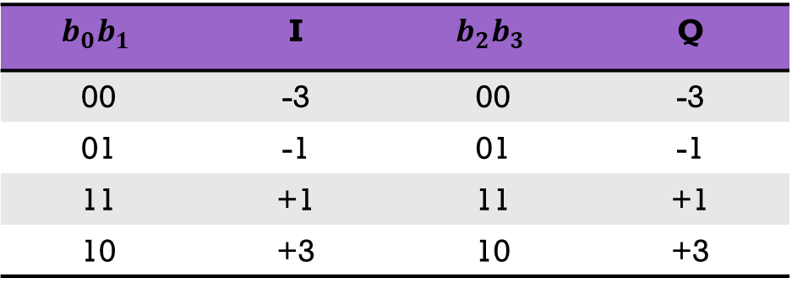
5G OFDM with 16-QAM
For 16-QAM, symbol mapping is done as follows:
$$b_{0}b_{1}$$ | I | $$b_{2}b_{3}$$ | Q
00 | -3 | 00 | -3
01 | -1 | 01 | -1
11 | +1 | 11 | +1
10 | +3 | 10 | +3

Slide 10
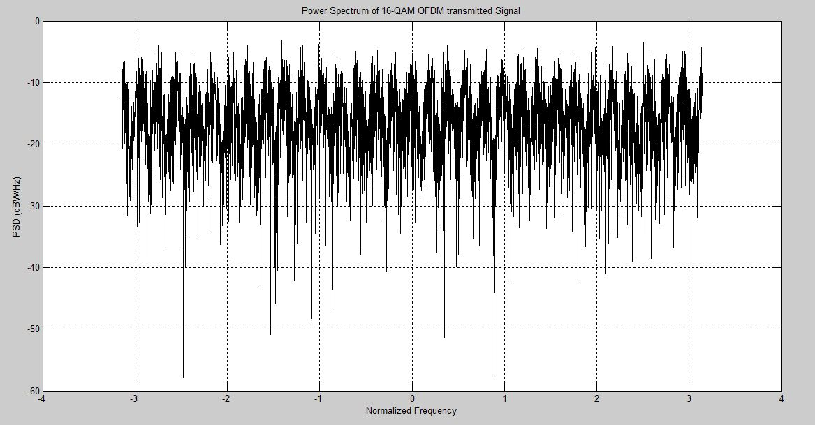
PSD of transmitted signal in case of 16-QAM
PSD has an average value of around -15 dBW/Hz whereas in the QPSK case, it was around -25 dBW/Hz. So, we can say that, PSD significantly improves for 16-QAM. It can be improved by implementing higher order QAM such as 64-QAM or 256-QAM.

Slide 11
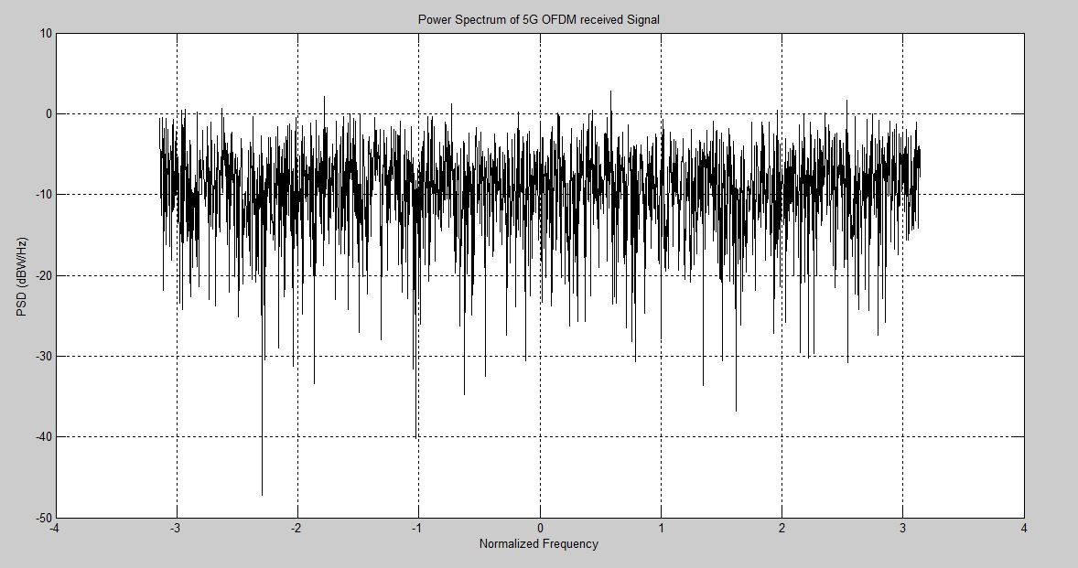
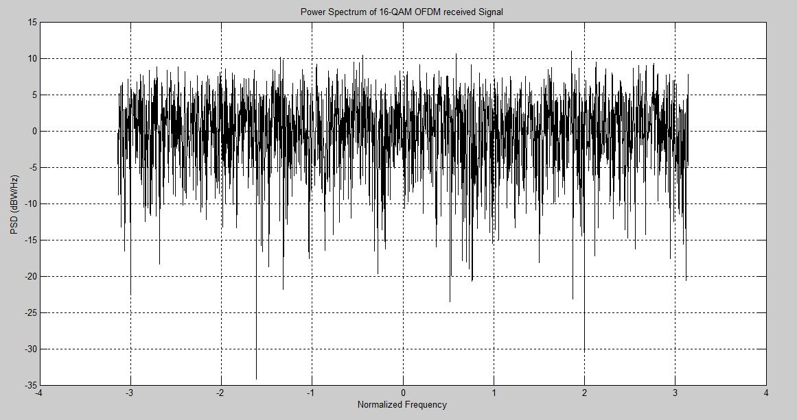
PSD of Detected Signals
QPSK case
16-QAM case
We observe significant improvements in the detected signal PSD in case of 16-QAM over QPSK which was the expected result.

Slide 12
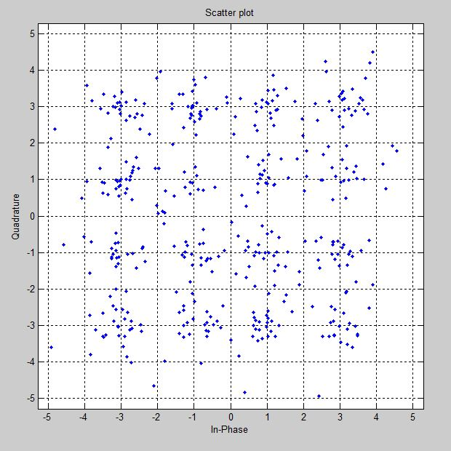
16-QAM Detection
We implemented the same G-matrix approach for detection of 16-QAM Symbols as we did for QPSK

Slide 13
Baseband Filtering
Transmitted signal is filtered before passing through the channel and in the receiver side a matched filter is used before CP deletion and FFT.
OFDM Transmitter
Matched
Filter
OFDM Receiver
Filter
CHANNEL
Figure: Block Diagram of OFDM transmission with Baseband Filtering

Slide 14
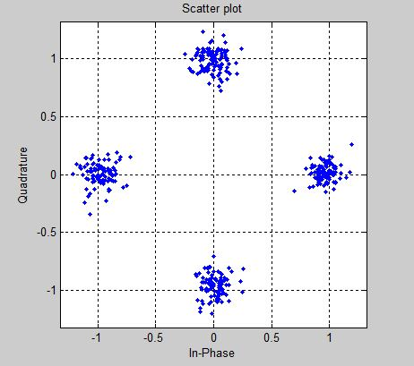
QPSK + Filtered OFDM
OFDM
F-OFDM

Slide 15
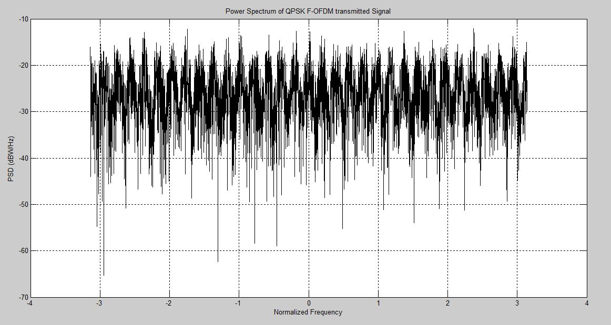
QPSK + Filtered OFDM (contd…)

Slide 16
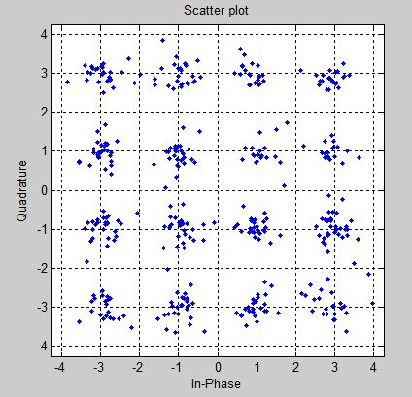
16-QAM + FOFDM
OFDM
F-OFDM

Slide 17
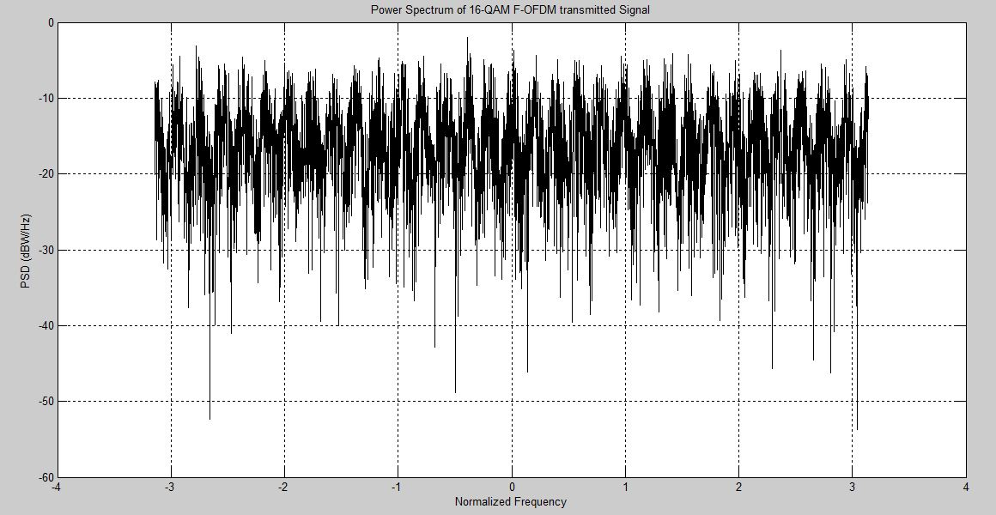
16-QAM + FOFDM (contd…)

Slide 18
MIMO Communication
We considered 4×4 MIMO Communication System
TX #1
RX #1
F-OFDM Transmitter
TX #2
RX #2
F-OFDM Receiver
TX #3
RX #3
TX #4
RX #4
Figure: MIMO F-OFDM System

Slide 19
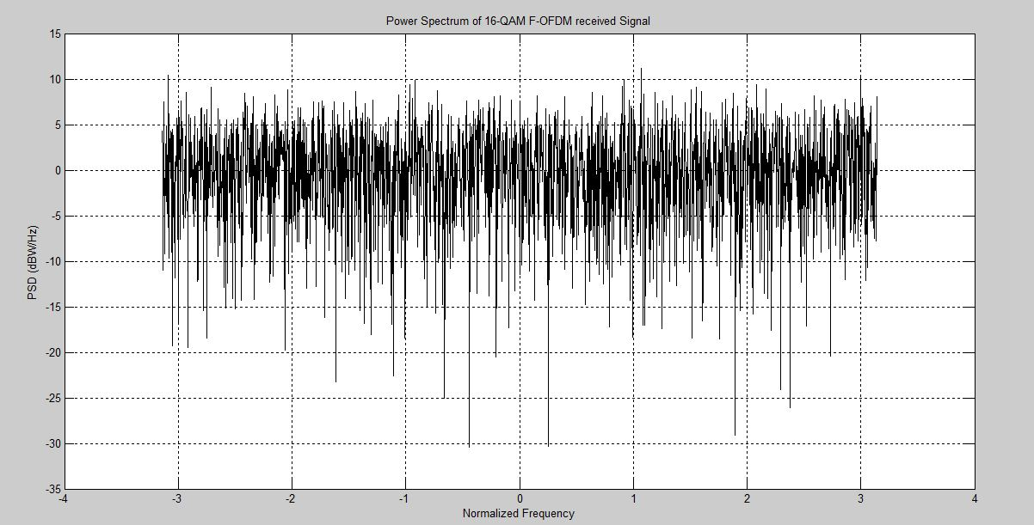
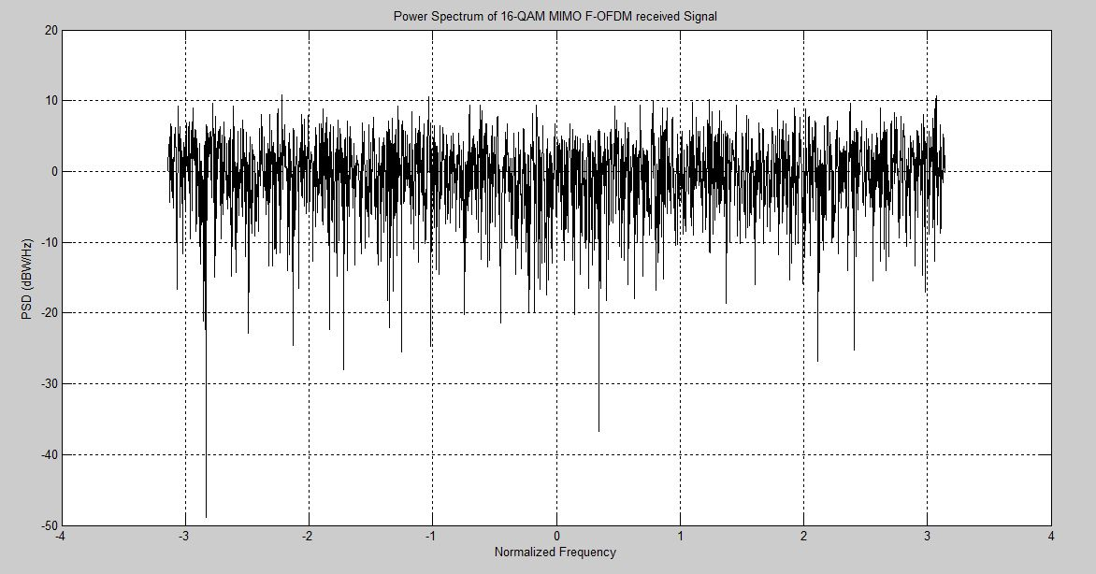
Received Signal PSD Comparison
(With & without MIMO)
Without MIMO
With MIMO

Slide 20
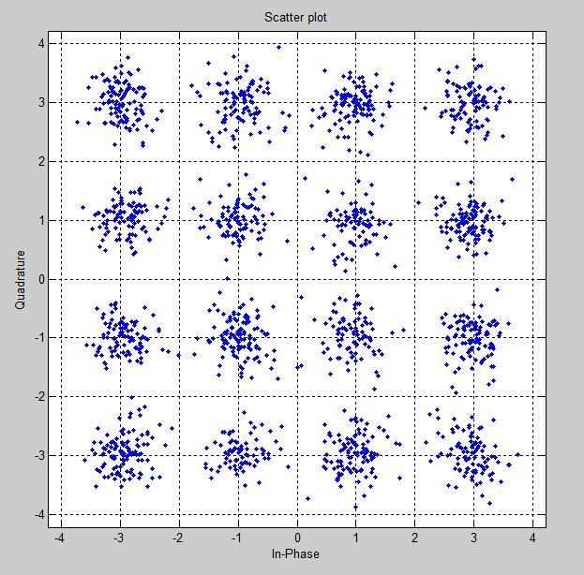
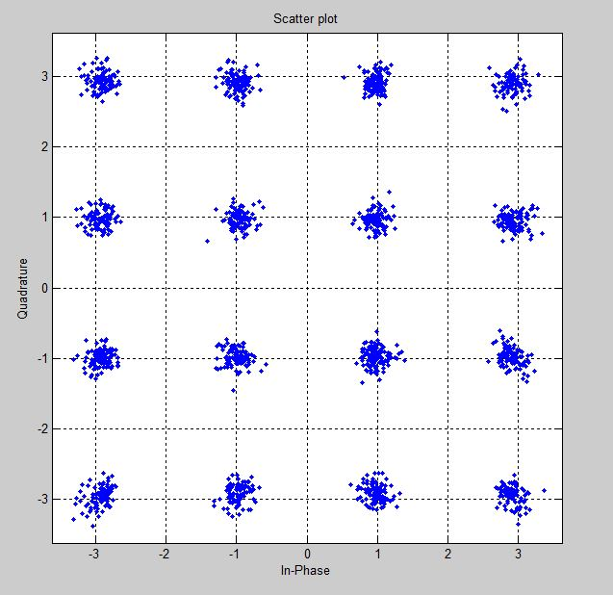
MIMO Symbol Detection
For SNR = 18 dB
For SNR = 22 dB

Slide 21
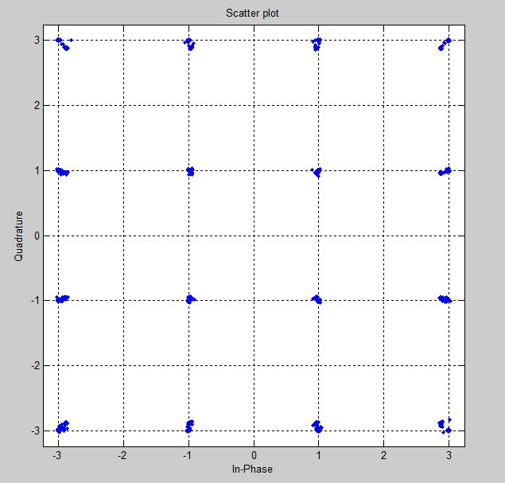
Effect of Noise
Due to noise, signal detection deteriorates. The following figures explain this claim.
16-QAM F-OFDM MIMO with noise (22 dB)
16-QAM F-OFDM MIMO without noise

Slide 22
Conclusion
We observed 5G OFDM communication system with QPSK used for symbol mapping and observed the PSD of the TX and RX signals
Then, instead of QPSK, we implemented 16-QAM modulation and observed the concerning outputs and compared the results
Then we implemented Baseband Filtering (FOFDM) for both the QPSK and 16-QAM modulations and compared the results
We implemented 4×4 MIMO on the existing F-OFDM system and observed that for MIMO, higher SNR is needed.
Currently, we are working on the MIMO system to get better result in terms of the detected symbols with minimum SNR.

Slide 23
THANK YOU

